Slide 1
Trend Explorer: An Exclusive Show Experience
Exhibitor Brief

Slide 2
Trend Explorer Is Back for More in 2025
Introduction
After last year's success, Connections powered by CSSI and Acxion™ Foodservice is partnering with Dot Foods Innovations to focus on 2025's exciting foodservice trends, giving participating manufacturers a chance to put their products in the spotlight by showing a trend in action with samples only served during the preview.
When is Trend Explorer?
Wednesday, April 16, 2025
11:45 a.m.–2:15 p.m.
Colorado Convention Center Halls E & F.
Participating exhibitors only. Show floor will close from 11 a.m.–3 p.m. for event.
The goal? To create a high-impact, multi-course tasting experience that captivates and inspires national account operators with every delicious bite.
Manufacturers have so much to gain for participating, and it's absolutely free. This deck has all the details. Ready?

Slide 3
Introduction
Who should be included in this process?
Here is who we recommend to get involved:
Your culinary team, if applicable
Those involved in running your exhibit
Anyone else you might need to execute your vision

Slide 4
Introduction
What are the benefits of participating?
Inclusion in the digital app that guides the operator through Trend Explorer: An Exclusive Show Experience
A high-impact chance to show operators how your product is trend-relevant and flexible on any menu
Cross-sampling opportunities, which can get your product in more places across the show, with increased branding and menu signage
It’s a fun and interactive reason for operators to visit your booth– and a great conversation starter
All of this and more, at no extra cost to you

Slide 5
About
Who is Connections powered by CSSI?​
We Bring Integration to a Complex Foodservice Landscape.​
Together, with Acxion™ Foodservice, we are the largest, most experienced sales and marketing agency in the foodservice industry with unmatched access and connectivity.​
Strategy & Research​
Foodservice Branding​
Operator Engagement​
Content​
Digital & Media​
Culinary​
Analytics​

Slide 6
About
Who is Acxion™ Foodservice?​
​Through a suite of complementary sales, marketing and technology solutions, we drive business growth, every day. ​
Operator Sales​
Field Sales​
K-12 & Colleges & Universities ​
Regional Chains​
Non-Commercial​
Distributor Sales​
Market Support​
Back of House Services​

Slide 7
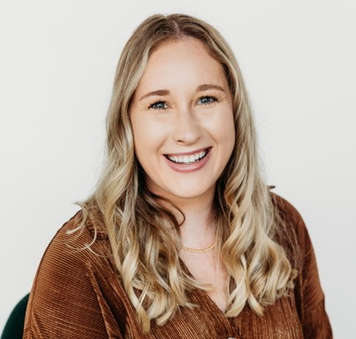
About
Your Connections power
Megan Dickey
Matthew Luaders
Steve Madonna
Project Manager
megan.dickey@acxion.com
SVP, Culinary Marketing
matthew.luaders@acxion.com
Sr. Director of Culinary
steve.madonna@acxion.com

Slide 8
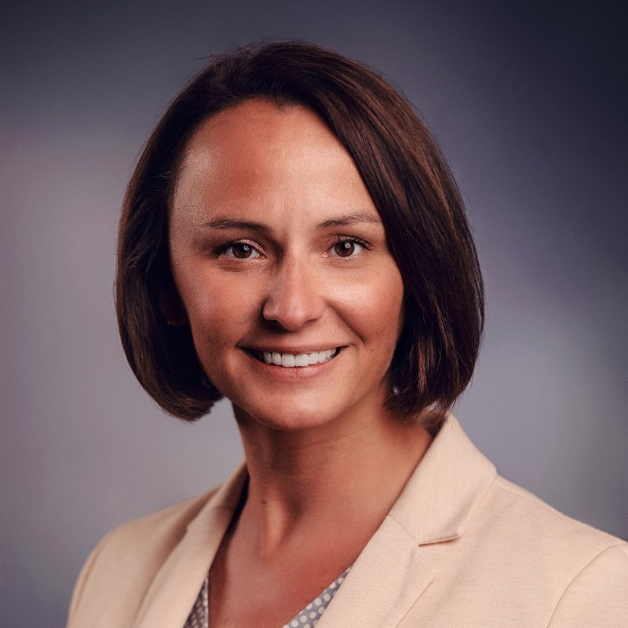
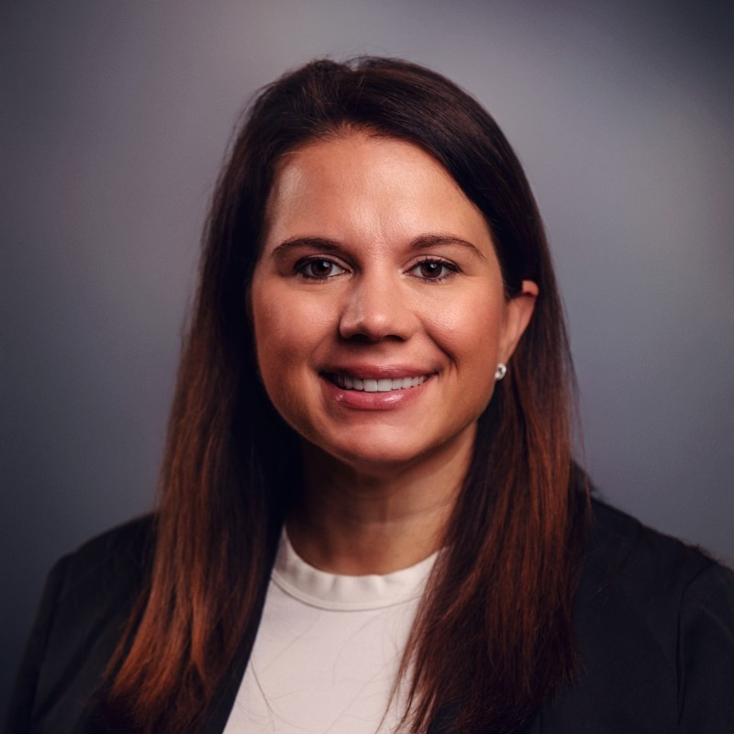
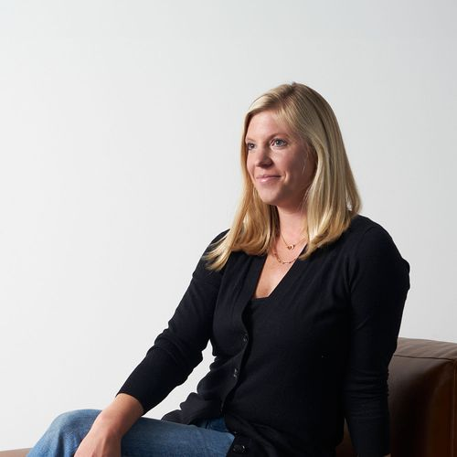
About
Your Dot Foods Team
Charlsie Pinkerton
Eleni Tsaloufis
Tim Gump
Trade Show Manager
charlsie.pinkerton@DotFoods.com
Director of National Accounts
ETsaloufis@DotFoods.com
Corporate Chef
Tim.gump@DotFoods.com

Slide 9
Process
Let your fellow booth preview exhibitors use your product as part of their sample concepts. It's optional but participating gives your brand greater visibility and more call-outs on menu signage at the show. Keep in mind:
Supplying your products to others should be at no cost to them.
Reciprocally, using products from other exhibitors will be supplied to you at no cost.
This can be a fun way to see how your product meets other trends. Sign up to offer your product no later than February 7, 2025.
Step 1:
Want to share your product with other manufacturer exhibitors?

Slide 10
Process
Living for Now
Step 2:
Pick a trend.
Global Breakfast
Coffee, Coffee, Coffee
Explore the trends illustrated in the following slides, then select one that your product can really bring to life as a sample at the show.
Claim your trend by Friday, February 7, 2025.
Spicy and ...
Social Media Sensations
Functional and Hyper-Personalized Nutrition

Slide 11
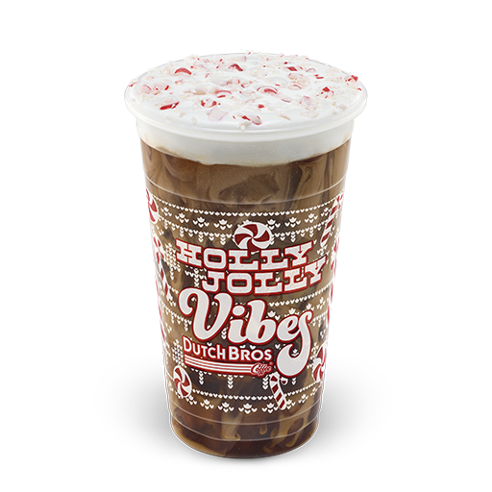
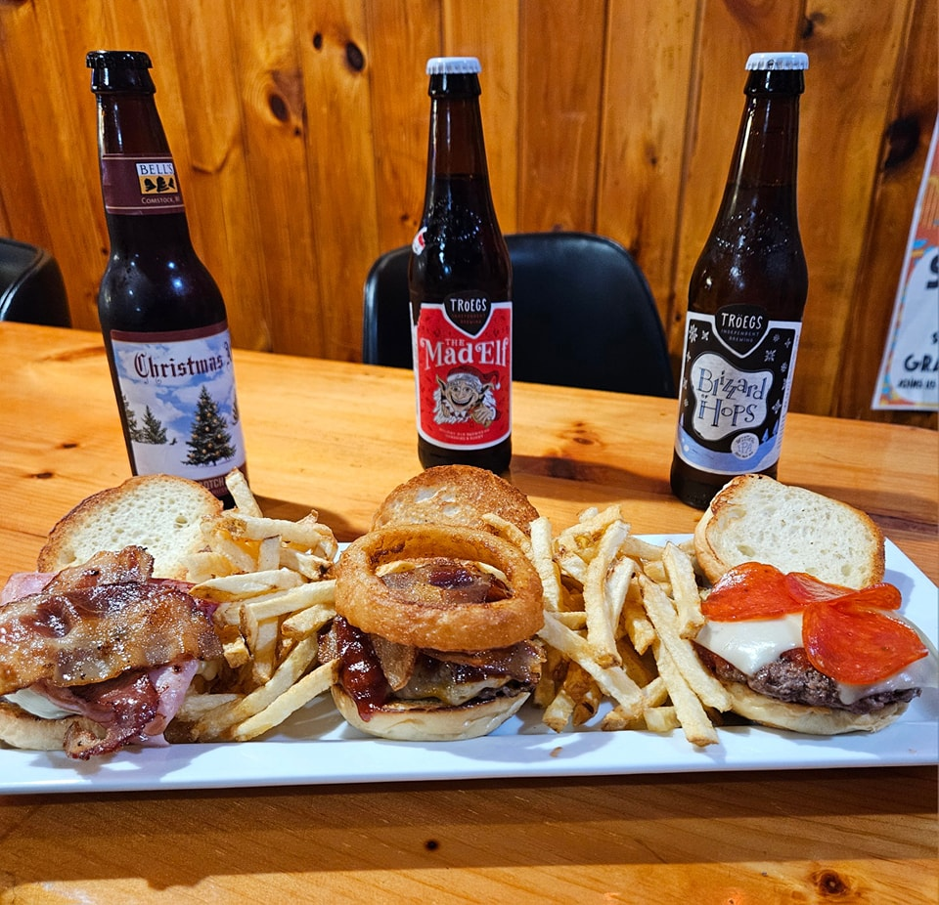
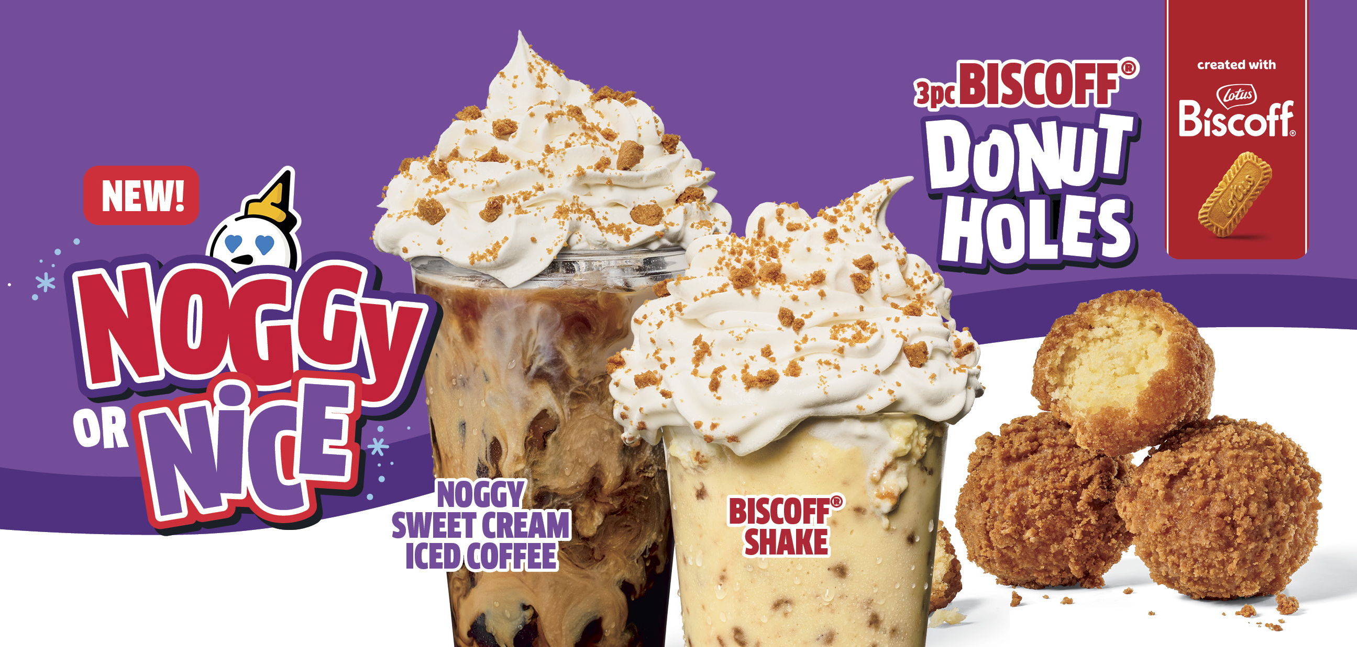
Trends
Living for Now
With inflationary tough times, the ‘treat yourself' mentality prevails, and even those cutting back are finding reasons to indulge in foodservice.
Consumers see dining out as a well-deserved treat, leading to the growth of snacking and indulgent menu options like over-the-top coffee, dessert beverages, and sweet treats, which are perceived as affordable luxuries.
In an era where cost-consciousness is the norm, these small pleasures remind consumers that a little treat can go a long way in brightening our day.
Candy Cane Mocha Cold Brew
Burger Slider Flight with Fries from Selinsgrove Hotel, Selinsgrove, PA
Biscoff Shakes and Donut Holes
1 Datassential, 2025 Trends.

Slide 12
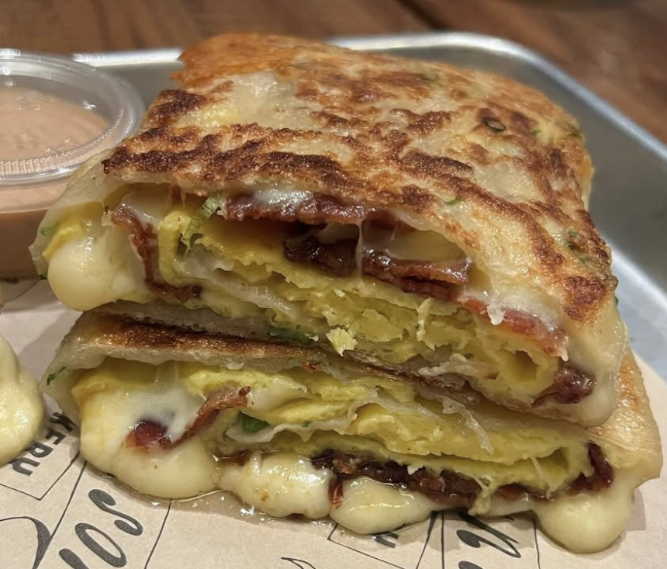
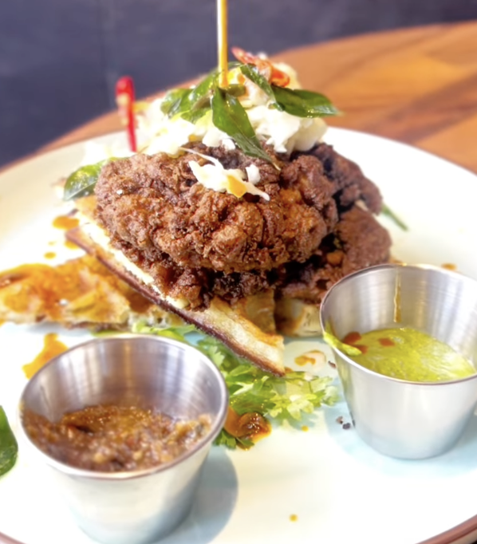
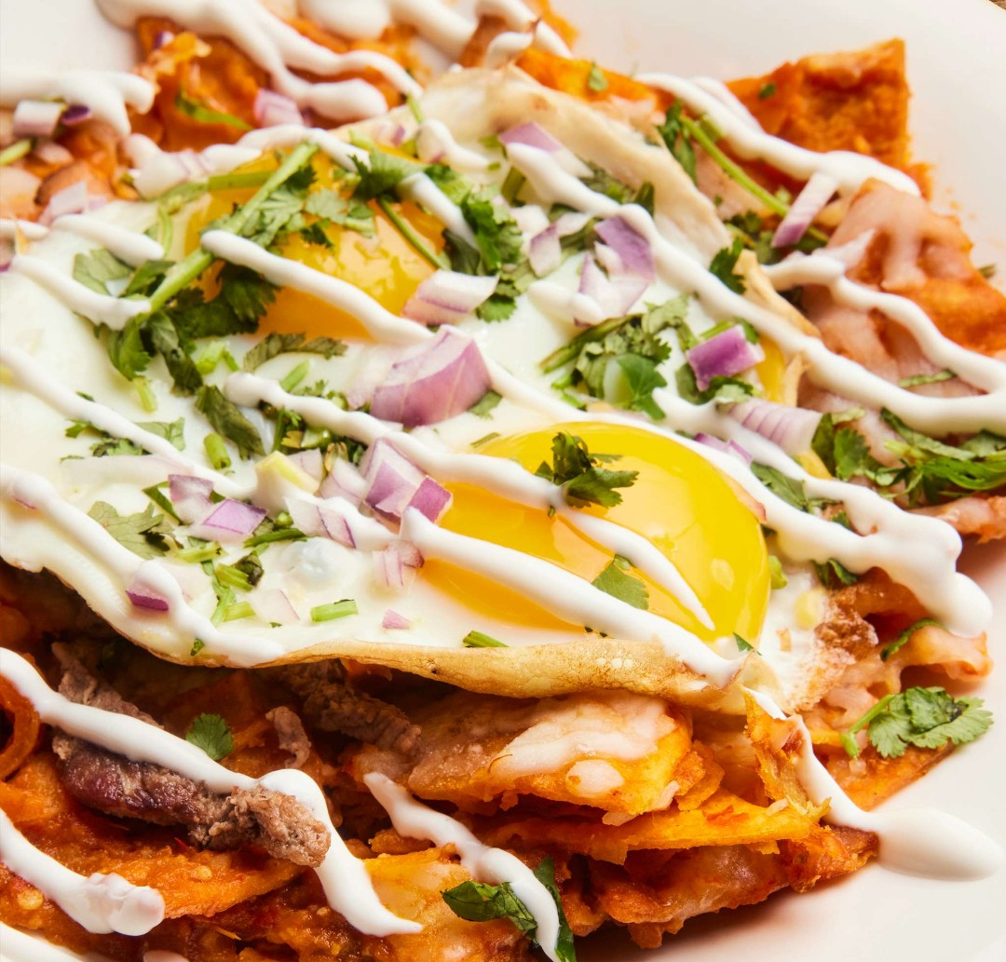
Trends
Global Breakfast
Consumers seek experiential elements that bring a sense of adventure to the plate. Global breakfast options are trending on menus, delivering novel, convenient, and craveable options.
While Mexican breakfast dishes like chorizo-stuffed omelets, chilaquiles, and breakfast tostadas have long been a hit, a new wave of Asian-inspired breakfasts are stealing the spotlight.
Scallion Pancake Breakfast Burrito
46% of U.S. consumers are interested in global breakfast concepts.¹
87% of consumers like or love trying new foods.²
Parsi Fried Chicken + Dosa Waffle
Chilaquiles Bowl
1 Datassential, Global Breakfast Report, 2024.
2 Datassential, America in Transition Report, 2024.

Slide 13
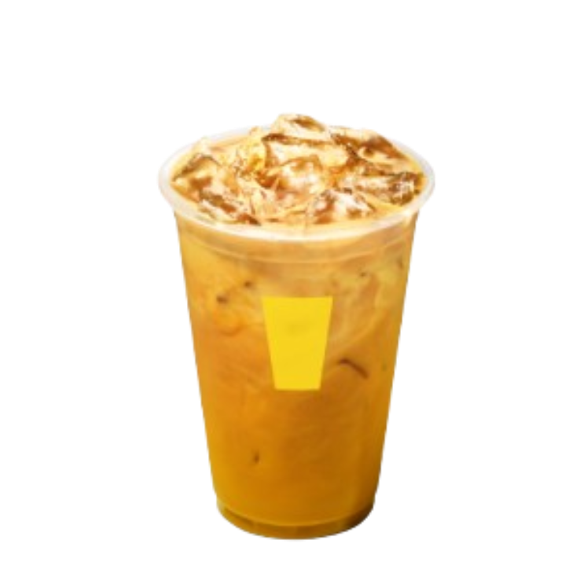
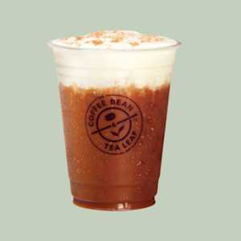
Trends
Coffee, Coffee, Coffee
As younger consumers increasingly gravitate toward non-alcoholic beverages, menus embrace flavorful, globally-inspired, and customizable coffee options that deliver approachable novelty and spark excitement.
44% of U.S. consumers are interested in global non-alcoholic beverages.¹
Turkish, Yemeni, Mexican and Filipino coffees are growing on menus, satisfying consumers with new flavors and spices.¹
Turmeric Spiced Latte
Turkish Coffee
Cardamom Cream Cold Brew
1 Datassential, Global Beverages Report, 2024.

Slide 14
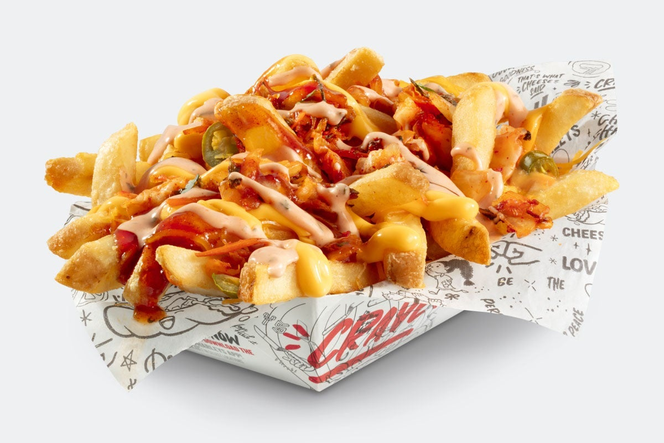
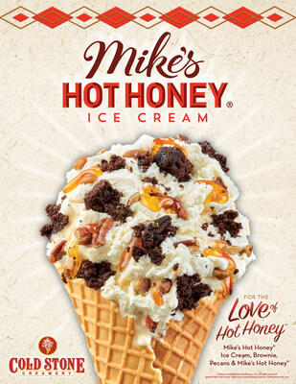
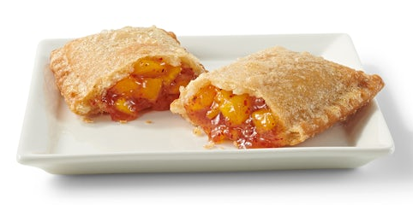
Trends
Spicy and …
Over the past year, sweet and spicy combinations (“swicy”) have dominated menus. Now, consumers are embracing a broader range of spicy flavors, including spice with unique combinations of sweet, savory, and umami elements. This shift is driving interest in globally inspired heat and complex flavor profiles.¹
Global sauces and condiments, such as Tajín, gochujang, sambal, and salsa macha (a thick, spicy Mexican salsa), are growing on menus, with Tajín seeing a 259% increase in 4-year growth and salsa macha rising 81%.¹
Operators should offer bold, multifaceted spice profiles that resonate with adventurous diners. 66% like or love the term “spicy.” ² And terms like "swicy" and the newer "swalty" (sweet + salty) are gaining traction.³
Kimchi Fries with Gochujang Sauce
For the Love of Hot Honey™️
Tajin Mango Fried Pie
1 Datassential Menu Trends, 2024.
2 Datassential’s Consumer Preferences Platform.
3 The New York Post, Gen Z cancels Ranch dressing – and other 2025 trends, 2024.
Notes:
https://www.foodbusinessnews.net/articles/27236-gen-z-influencing-restaurant-menu-trends-for-2025

Slide 15
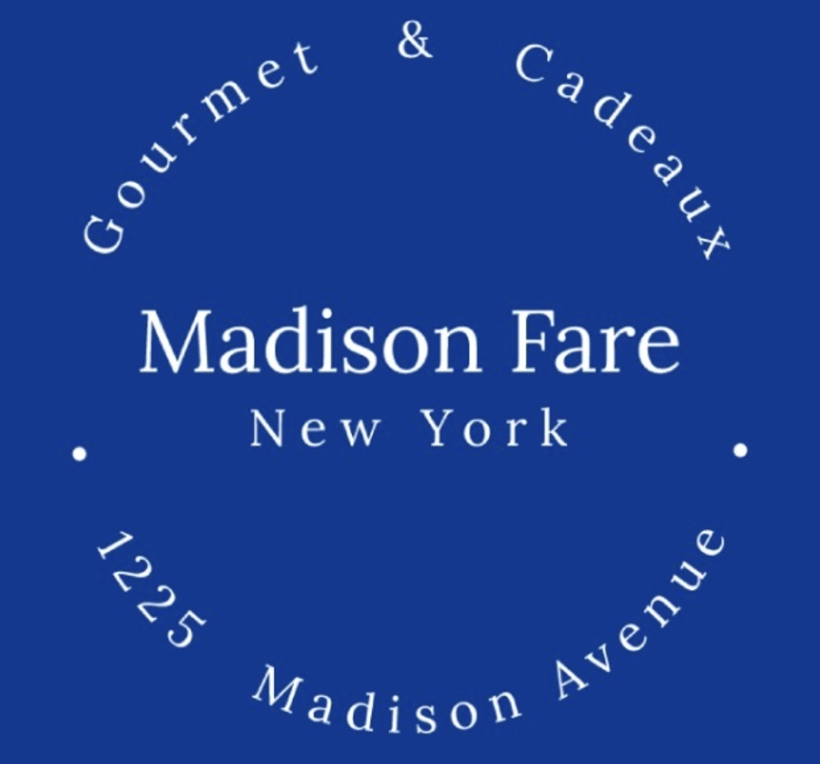
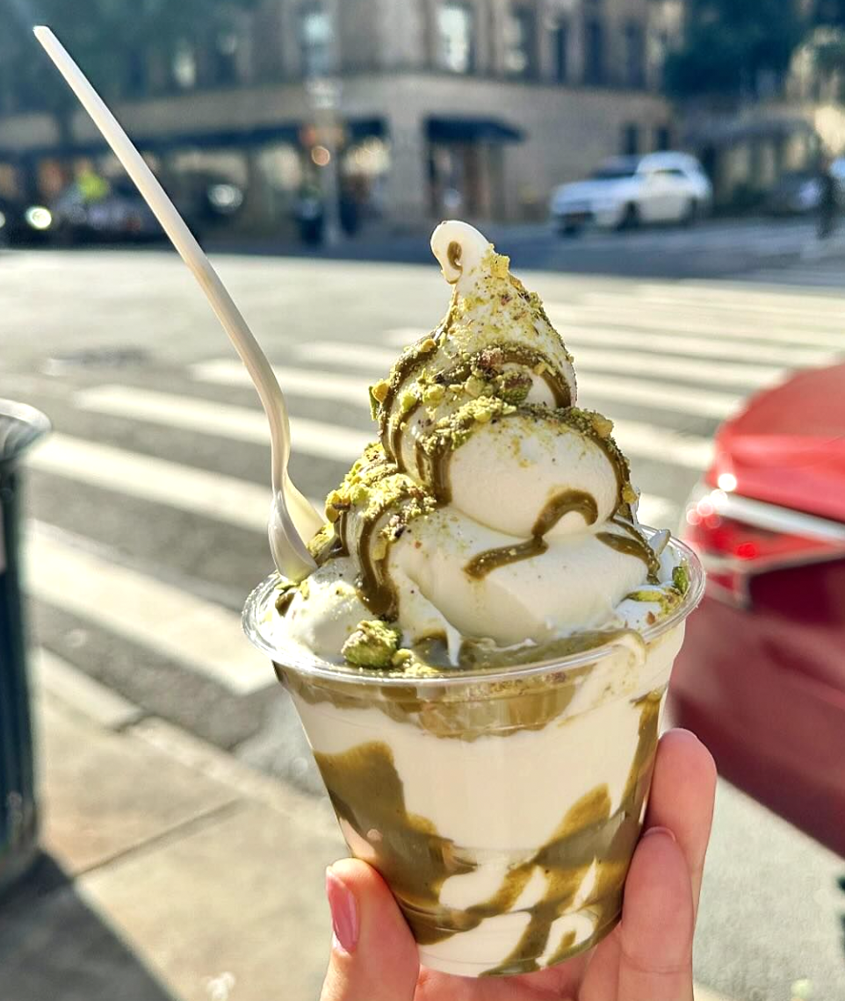
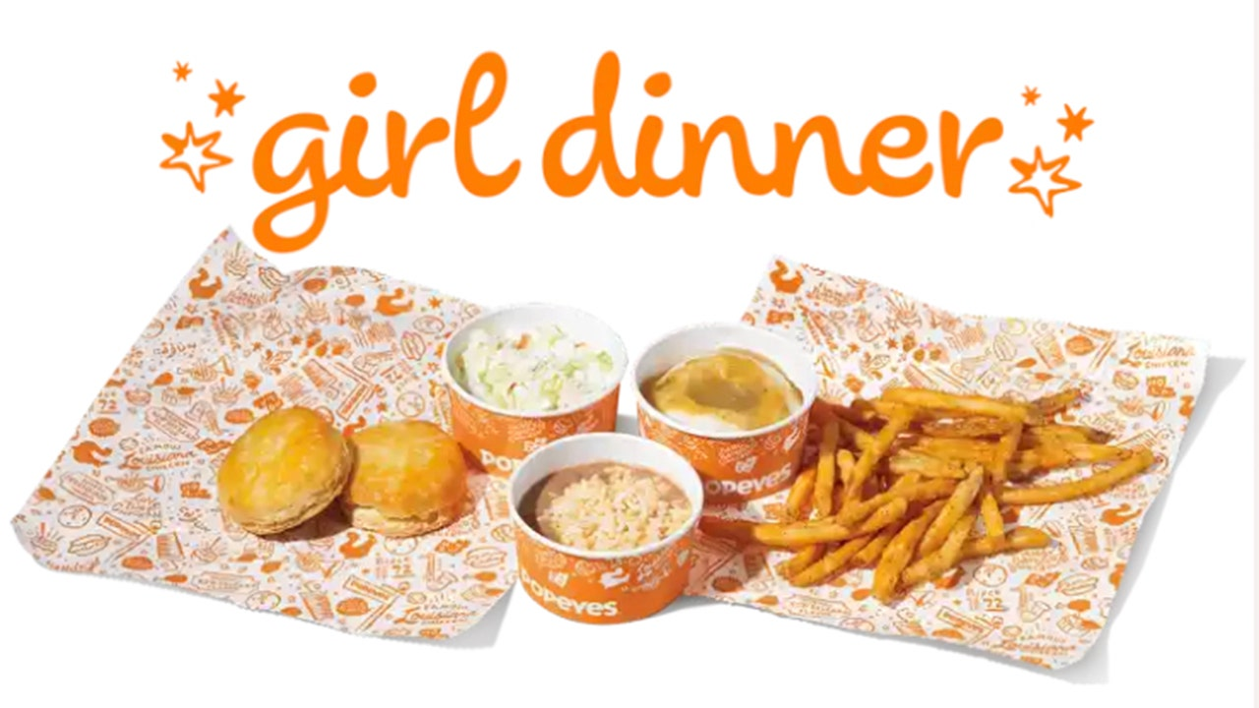
Trends
Social Media Sensations
Social media platforms like TikTok and Instagram have become powerful trendsetters in the foodservice industry.
Viral food challenges, visually stunning dishes, and influencer collaborations are quickly shaping consumer preferences and driving menu innovation, making social media a key player in the culinary landscape.
96% of consumers use at least one platform of social media.¹
Dubai Chocolate Frozen Yogurt
Cookie Dough Croissants
1 Datassential, Social Media Sensations, October 2024.

Slide 16
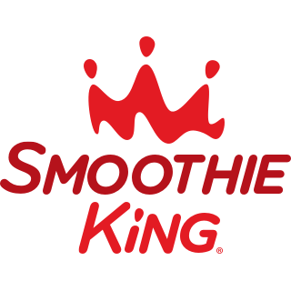
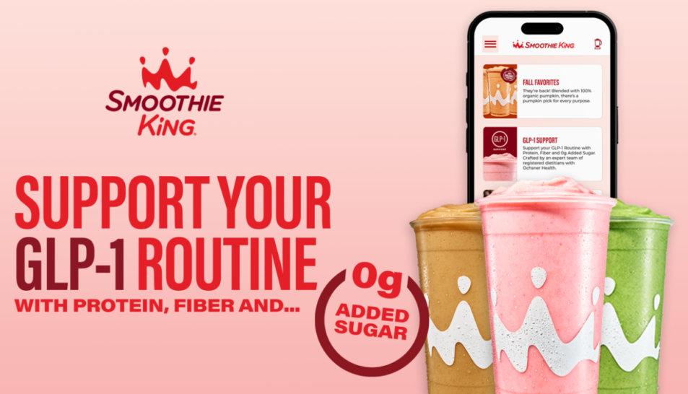
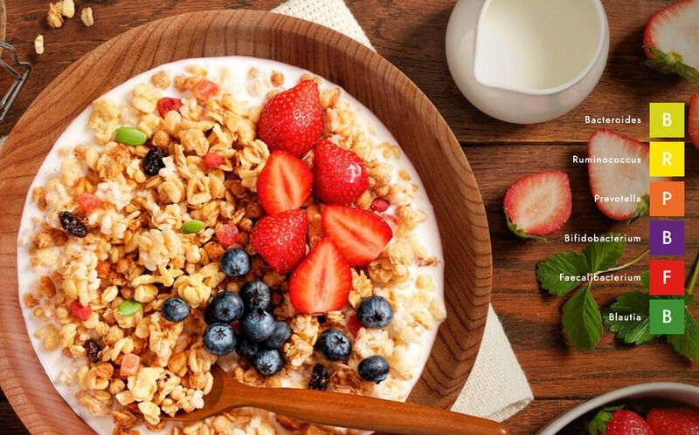
Trends
Functional and Hyper-Personalized Nutrition
As the popularity of GLP-1 weight-loss medications surges, consumers are increasingly seeking hyper-personalized nutrition to support nuanced health goals.
This shift is driving demand for nutrient-dense, smaller-portion meals that maximize nutritional value.
Foodservice operators can capitalize on this trend by emphasizing simplified health claims and offering menu items that align with holistic wellness goals, including hormone regulation and metabolic health.
GLP-1 Smoothies
45%
of consumers who follow a strict diet are currently taking or are interested in glp-1 medications.¹
Body Granola: granola blend tailored to your microbiome
1 Datassential Menu Labeling Report, 2024.

Slide 17
Process
Step 3:
Get free culinary support.
Need help brainstorming an idea for your trend? Or are you curious about how to make your concept stand out at the show?
Book a consultation call with the culinary team at Connections powered by CSSI; the chefs are happy to help work out logistics, provide inspiration, or be the "yes, and..." you're looking for.
Appointments are available from February 24-February 28, 2025.

Slide 18
Process
Once you have a delicious sample recipe concept that fits your trend perfectly, we want to know about it.
Deadline for submission is Friday, March 14, 2025.
Step 4:
Submitting your concept

Slide 19
Key Dates
Mark your calendars!
Key Dates
Join the Connections Powered by CSSI team as we discuss the program.
Option 1 | Tuesday, January 7th, 2025, from 2-3 PM CST
Option 2 | Friday, January 10th, 2025, from 1-2 PM CST
Deadlines: Submit your product as an option for product crossover Trend Sign-up | 2/7/25
Product crossover list will be distributed | 2/10/25
Window for consultations to review concept with Connections powered by CSSI team | Week of 2/24/25 Monday 2/24: 10 am - 3 pm CST Tuesday 2/25: 9 am -5 pm CST Wednesday 2/26: 9 am - 4 pm CST Thursday 2/27: 11 am - 2 pm CST Friday 2/28: 10 am - 1 pm CST
Deadline: Proposed concept submission Also, final date to request crossover sampling product from manufacturer. | 3/14/25
Show Dates Your signage will be provided at the conference. | April 15 – 17, 2025

Slide 20
Key Dates
Questions about Trend Explorer? Join us for a conversation.
Connections Powered by CSSI will be hosting two virtual sessions to explain the process, followed by a Q&A.
We'll send out separate meeting invitations, so feel free to accept the option with the time that works best for you. Hope to see you soon!
Join the Connections Powered by CSSI team as we discuss the program.
Option 1 | Tuesday, January 7th, 2025, from 2-3 PM CST
Option 2 | Friday, January 10th, 2025, from 1-2 PM CST

Slide 21
Your Next Steps
Please Fill These Out!
If you plan to allow other manufacturers to use your product(s) in their concept for the show, please use the link below to sign up.
Please sign up for one trend to use as inspiration for your concept.
Schedule your consultation with Connections Powered by CSSI.
Please submit your recipe concept based on the trend you signed up for.
PRODUCT CROSSOVER FORM
TREND SIGN UP FORM
SCHEDULE CONSULTATION
CONCEPT SUBMISSION

